Slide 1
Hospital Management System
Done by
M.Madhuri&K.Sireesha(Team-8)
Guided By
-Javeed sir

Slide 2
Contents
Introduction
Abstract
About Admin Module
About Doctor Module
About User Module
Use-Case Diagrams
E-R Diagram
Screenshots

Slide 3
Introduction
In this case study, we will design and develop a fullstack healthcare application which aims to streamline patient management and improve healthcare services in a medical facility. The application will facilitate the interaction between patients, doctors, and administrative staff, ensuring efficient appointment scheduling, medical record management, and communication.
Scope:
• Efficient Appointment Booking: Enable patients to schedule appointments online, reducing waiting times and improving overall patient experience.
• Comprehensive Medical Records: Store and manage patient medical records electronically for easy access by healthcare providers.
• Real-time Communication: Allow patients and doctors to communicate securely through the platform, enabling follow-up discussions and quick responses to queries.
• Administrative Automation: Simplify administrative tasks such as handling medical records, staff records.

Slide 4
In this project we have this 3 Three Modules:
Admin Module
Doctor Module
Patient Module
Admin Module:
Admin can manage doctors like add, update delete the doctor details. To add new doctor details, capture details like:
1. Name POORNIMA C
2. Specialty Obstetrics and Gynecology
3. Experience 18 Years
4. Qualification MS (OG)
5. Designation Associate Professor/Consultant
• Admin can manage Patient details like add, update delete the patient details.
• manage Appointment details like reschedule and view the Appointment details.

Slide 5
Doctor Module:
• Doctors can view their appointment schedule, patient details, and medical history.
doctor can list their upcoming and completed appointment with following details in table
1. name of patient, contact no, symptoms.
2. upcoming appointments should be highlighted in green color and should add the consulting details with prescription as discussed below.
3. upcoming appointments have an option to reject/cancel appointments.
4. Doctor can view completed appointment with prescription.
• Doctor should capture from patient as consulting details in corresponding appointment:
• Doctor can update patient prescribe medications and recommend tests

Slide 6
Patient Module:
Patient can make new appointments with doctors and providing following information. Personal Information:
2. Full Name
3. Date of Birth
4. Gender
5. Contact Information (Mobile Number)
6. Brief description of symptoms or health
7. Nature of the visit (e.g., general check-up, specific medical issue)
8. Preferred date and time
• Patients can view upcoming appointments with doctor name and date of appointment and can reschedule appointments. all the upcoming appointments should display in table
. • Patient can access completed consulting details with doctor (completed appointment) in table with following details date of appointment, treatment or diagnosis and doctor name.

Slide 7
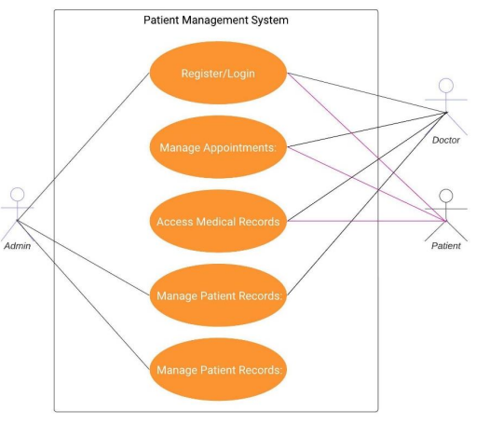
Use-Case Diagram:

Slide 8
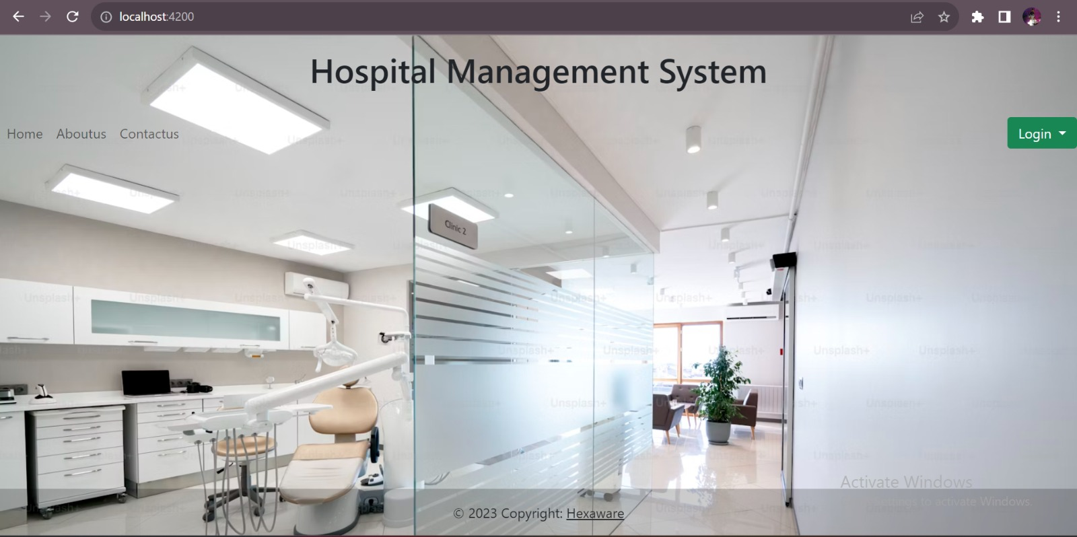

Slide 9
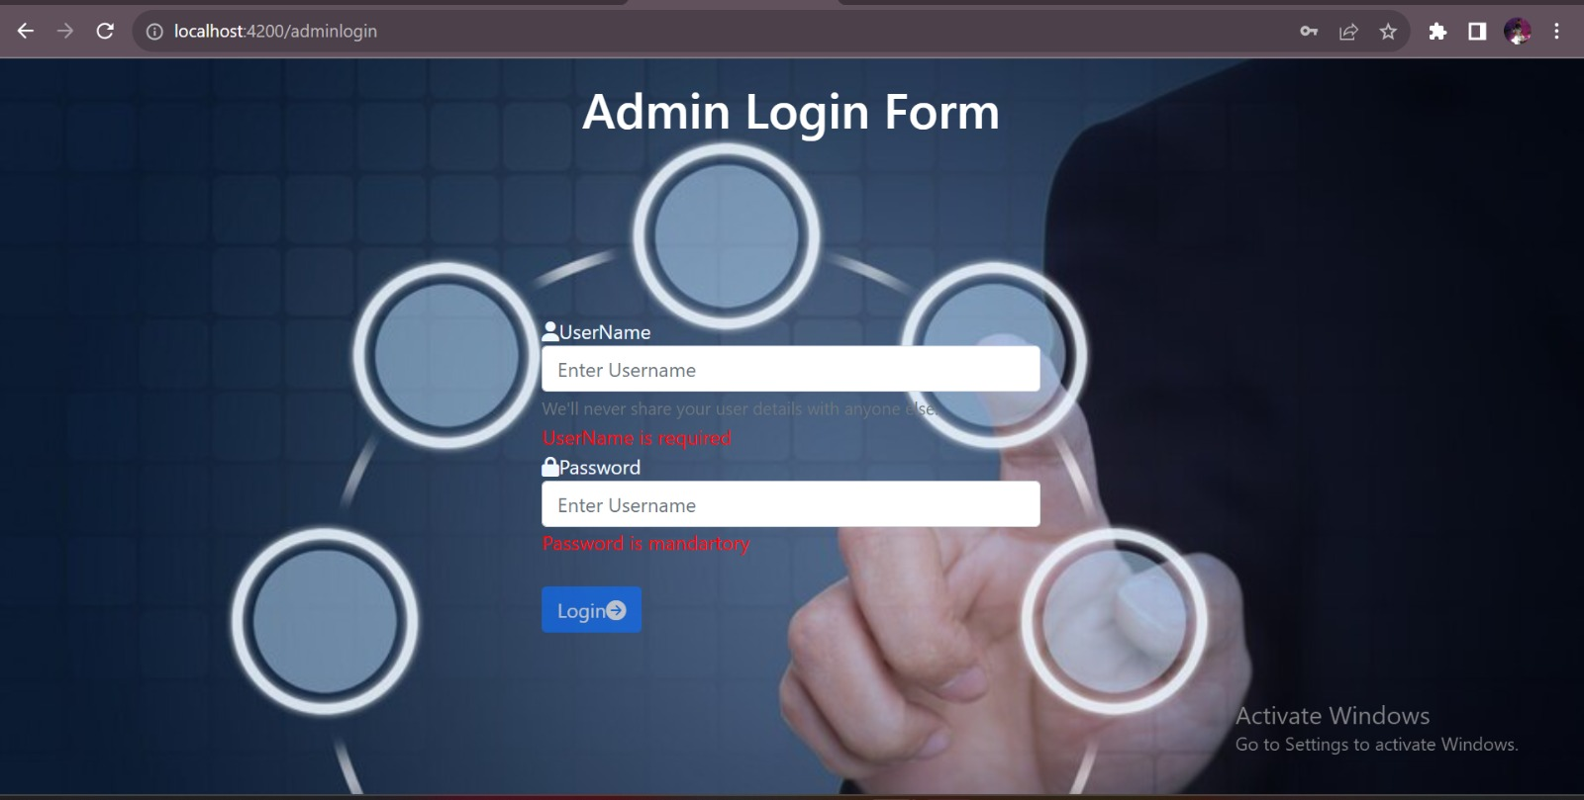
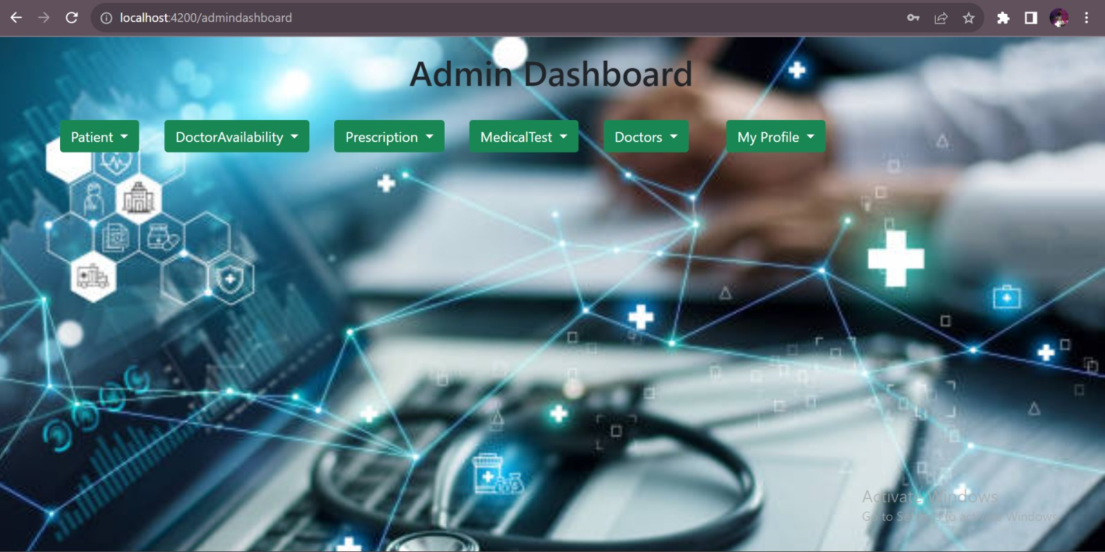

Slide 10
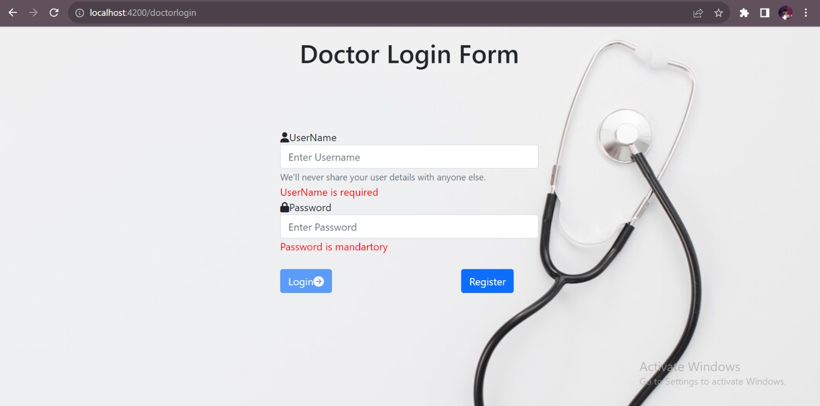
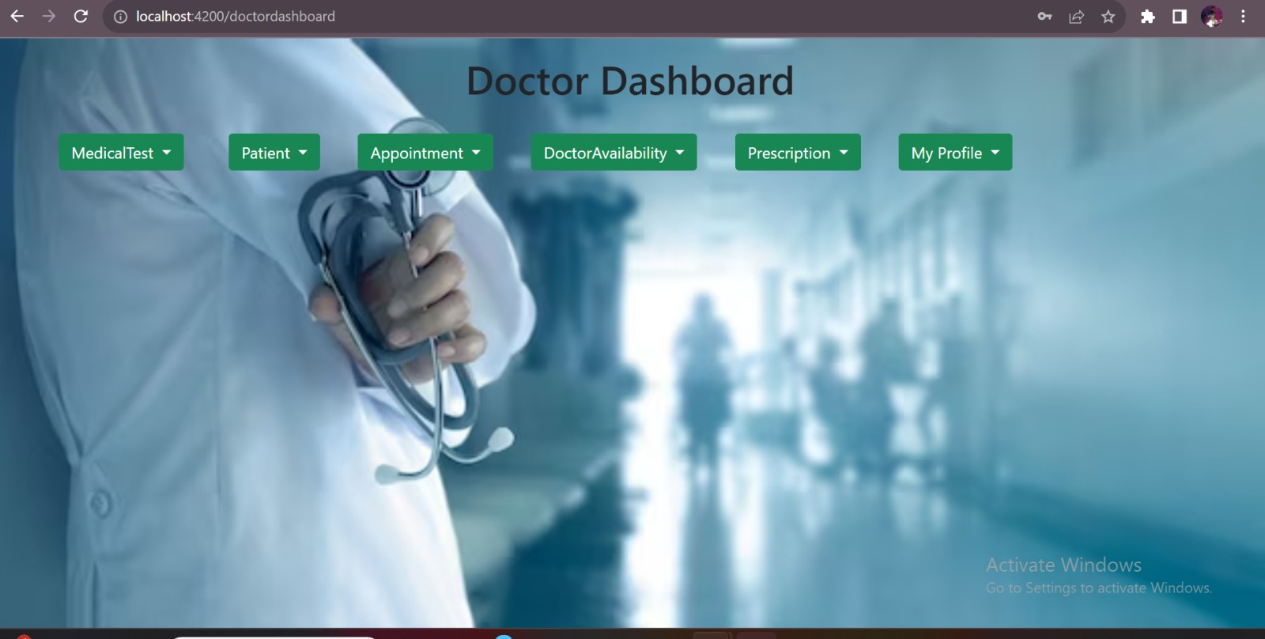

Slide 11
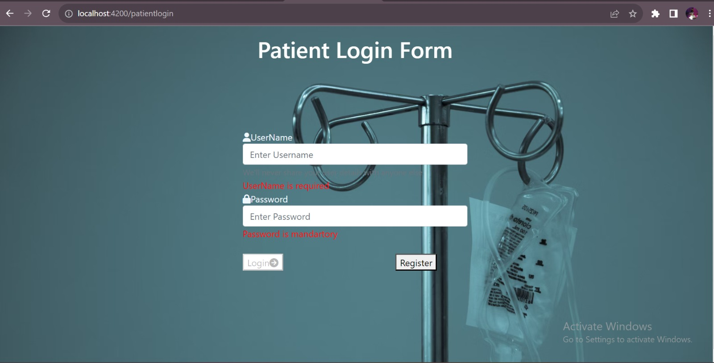
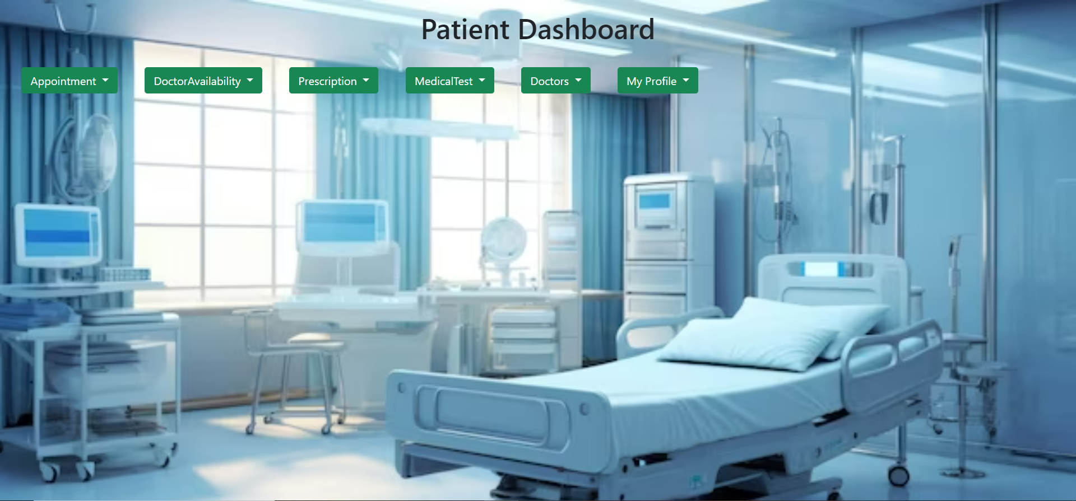

Slide 12
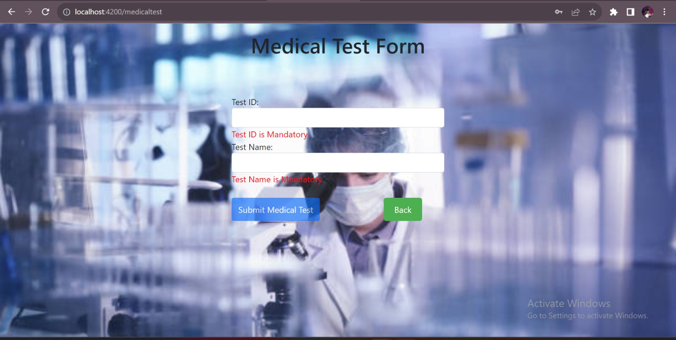
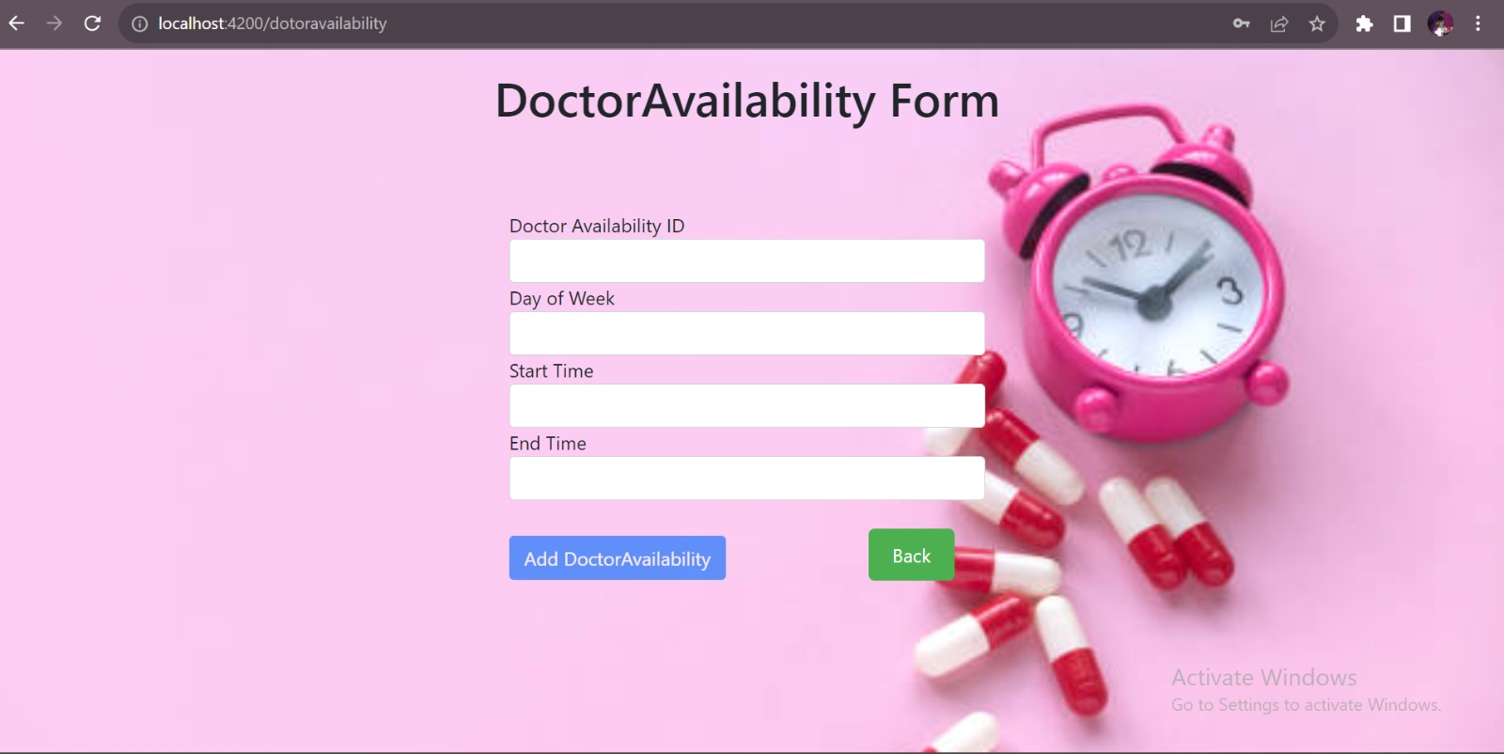

Slide 13
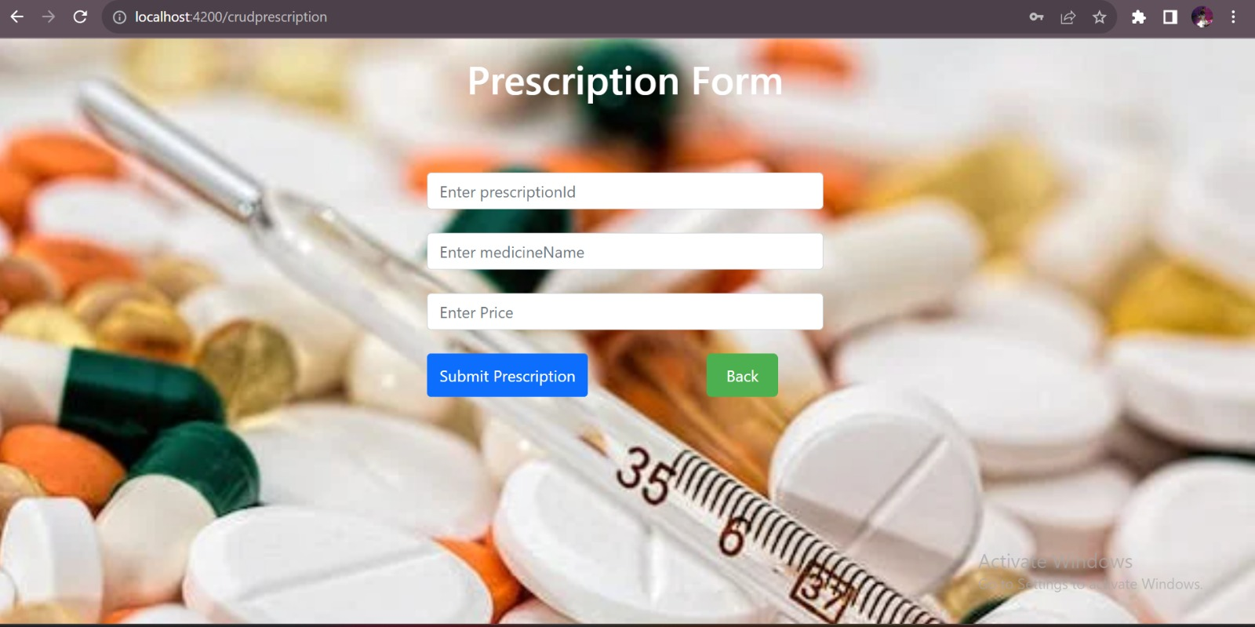
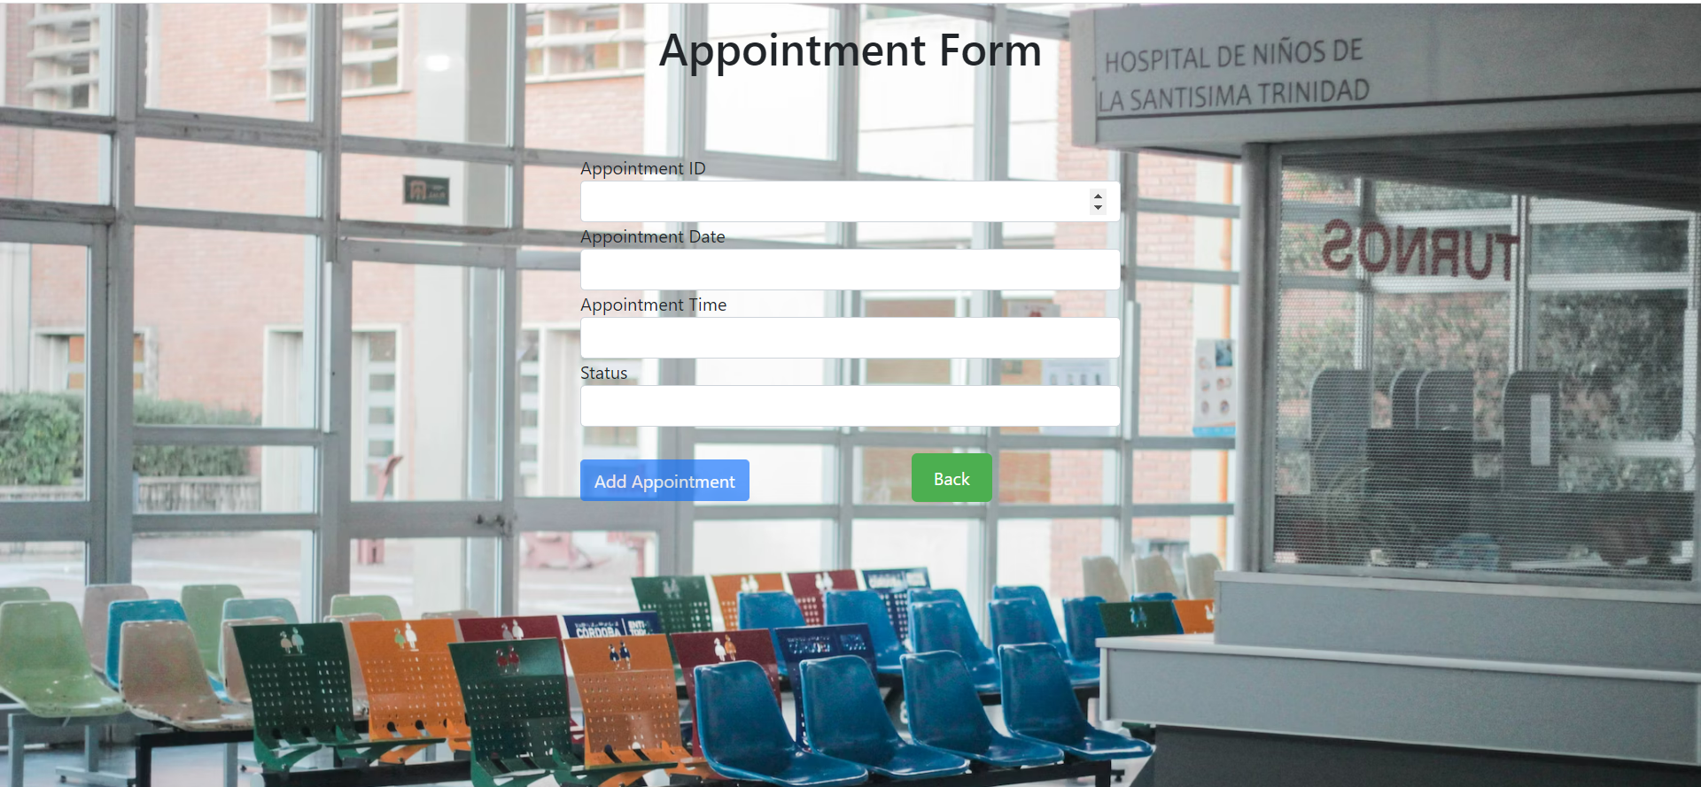

Slide 14
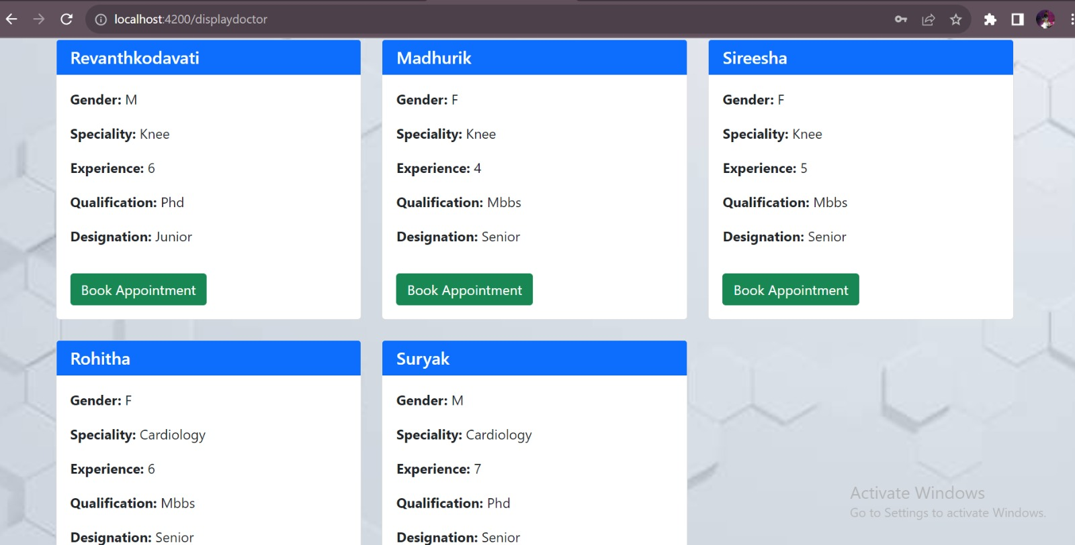
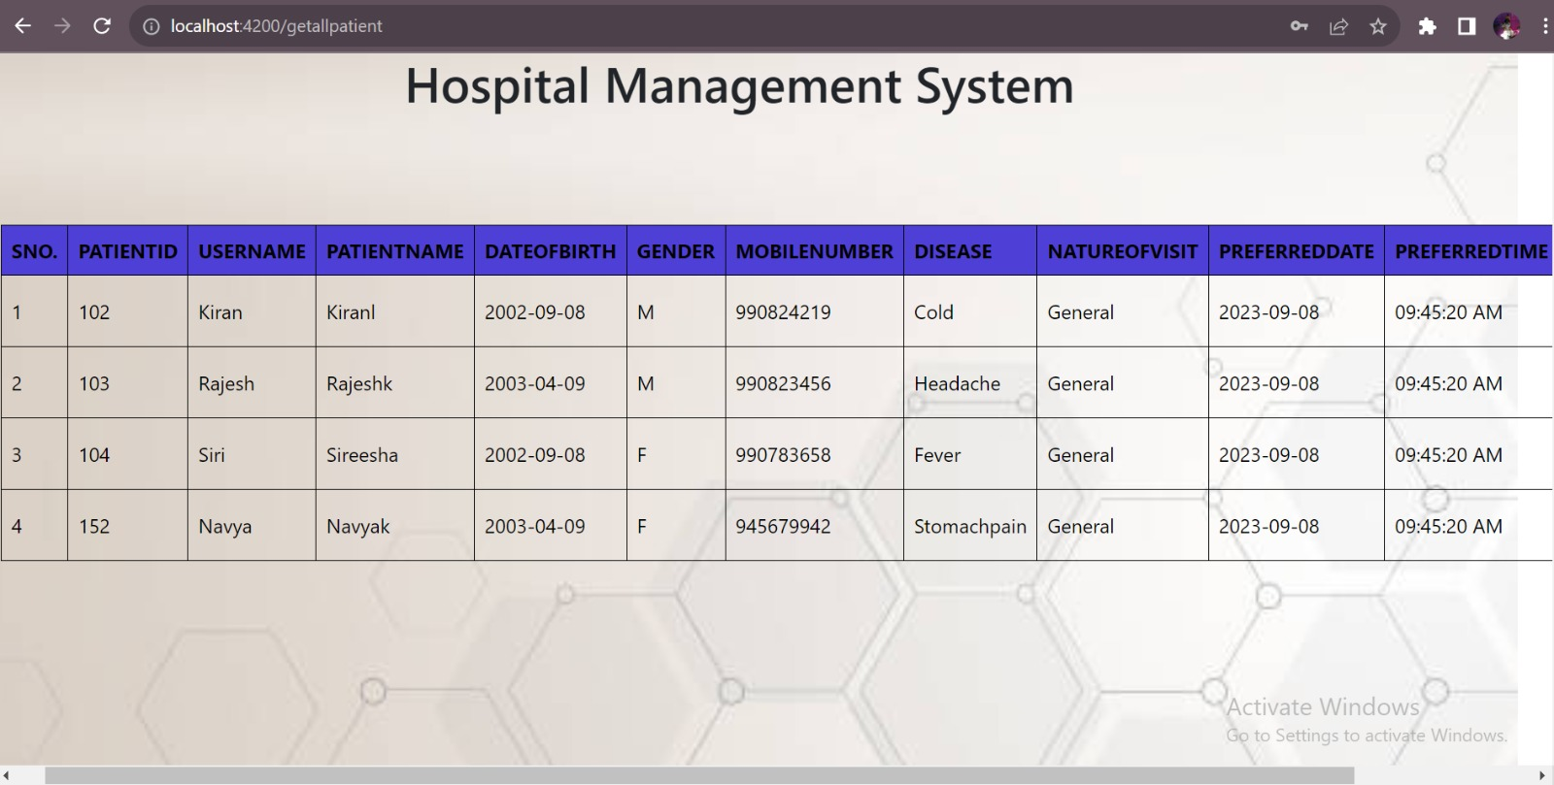

Slide 15


